Slide 1
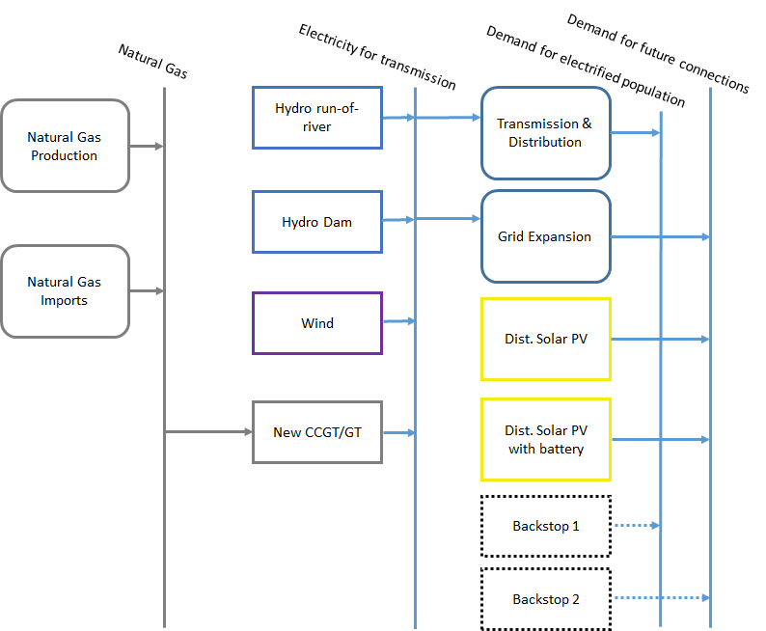
Characteristics and types of energy demand
Resources
Primary
Secondary
Final

Slide 2
Characteristics and types of energy demand
Where does the energy demand come from?
  Households (rural and urban) – e.g. cooking, heating, cooling, lighting, appliances
  Industry – e.g. energy for chemical processes, steam production
  Commerce – e.g. cooling of products, energy for warehouses, shopping centres
  Transport – e.g. fuel for cars trucks and buses, fuel for aviation, electricity for trains
  Agriculture – e.g. fuel for tractors, electricity for pumping water
  Others…

Slide 3
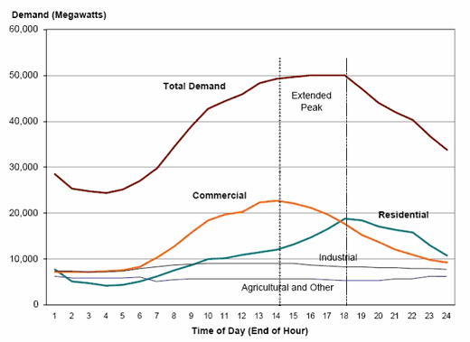
Characteristics and types of energy demand
Within each of these sectors, the energy demand varies over time…
…It can vary over the day, week and months, mainly because the activities of the consumers change (as seen in the previous lecture)
Source: Electropaedia

Slide 4
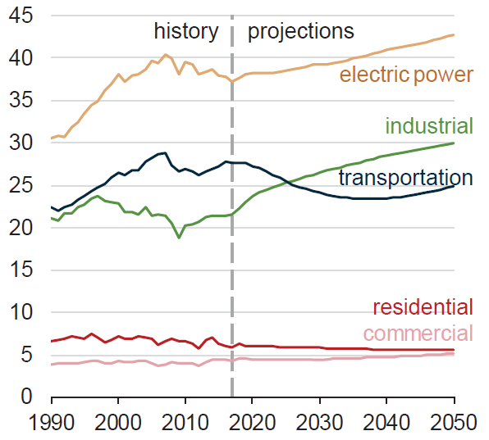
Characteristics and types of energy demand
Within each of these sectors, the energy demand varies over time…
US Energy consumption by sector [10^15 Btu]
…It can vary over years, e.g. because of population and economic growth
Source: EIA, Annual Energy Outlook 2018

Slide 5
Characteristics and types of energy demand
The long-term changes in demand must be considered when planning.
Capacity
Existing system capacity
Time

Slide 6
Characteristics and types of energy demand
The long-term changes in demand must be considered when planning.
Capacity
Demand for new capacities
Demand projection
Existing system capacity
Time

Slide 7
Characteristics and types of energy demand
Sample schedule of new capacity additions
The long-term changes in demand must be considered when planning.
Total system capacity requirements
Capacity
Demand for new capacities
Demand projection
Existing system capacity
Time

Slide 8
Characteristics and types of energy demand
Within each of these sectors, the energy demand varies over time and across different classes of consumers
For instance, within the residential sector, different demands might come from urban and rural households
Again, for rural households different demands might come from grid-connected and off-grid households

Slide 9
Characteristics and types of energy demand
Within each of these sectors, the energy demand varies over time and across different classes of consumers
Therefore, energy planners must make sure that the energy demand is met at any point in time for all the classes of consumers

Slide 10
Characteristics and types of energy demand
In the long-term planning of the energy system, when defining an energy demand, it is important to identify:
The energy carrier which the demand rises for
  E.g. electricity, heat, gasoline for transportation, biomass for cooking, etc.
The sector where the demand rises from;
  E.g. residential (urban and/or rural, off- or on-grid), industry, services, etc.
The average variability of such demand within a year.
  It is typically expressed by load curves
The current and expected annual average demand;
  It is hard to predict the future demand, but scenarios can be elaborated

Slide 11
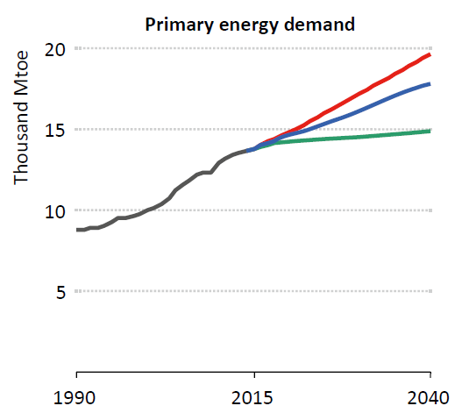
Characteristics and types of energy demand
Since future is uncertain, scenarios of energy demand are made for future years, assuming different levels of growth
Scenarios
Current policies scenario
New policies scenario
450 scenario
Source: IEA, World Energy Outlook 2016

